Slide 1
Special Projects Team

Slide 2
Overview
Special Projects Team
PackML
SPT Framework
Github.com

Slide 3
SPT Team Background
Formed in 2021
To formalize and control projects that Beckhoff takes on
To develop, formalize and control the tools and framework for TwinCAT programming in various industries
Implement good coding practice and framework on customer machines

Slide 4
SPT Group
What We Provide....
9 highly experienced software engineers who are very familiar with the use and application of Beckhoff products. (150 years of cumulative experience).
Help Establish requirement specification
On the job technical training of software development and hardware
Supporting documentation
Sign off acceptance
Controlled and collaborative software & documentation repository (Azure DevOps)
Work with local Application Engineers to fulfill requirements
Framework to build applications

Slide 5
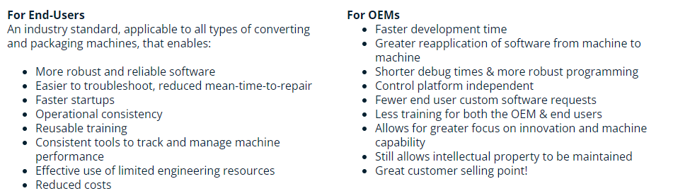
PackML - OMAC
What is PackML?
Benefits of PackML

Slide 6
PackML – Our View
3 major topics in PackML
State Engine – Run Machine and Equipment Modules
PackTags – Communication to outside
Programming Methodology
Machine Module / Equipment module / Component

Slide 7
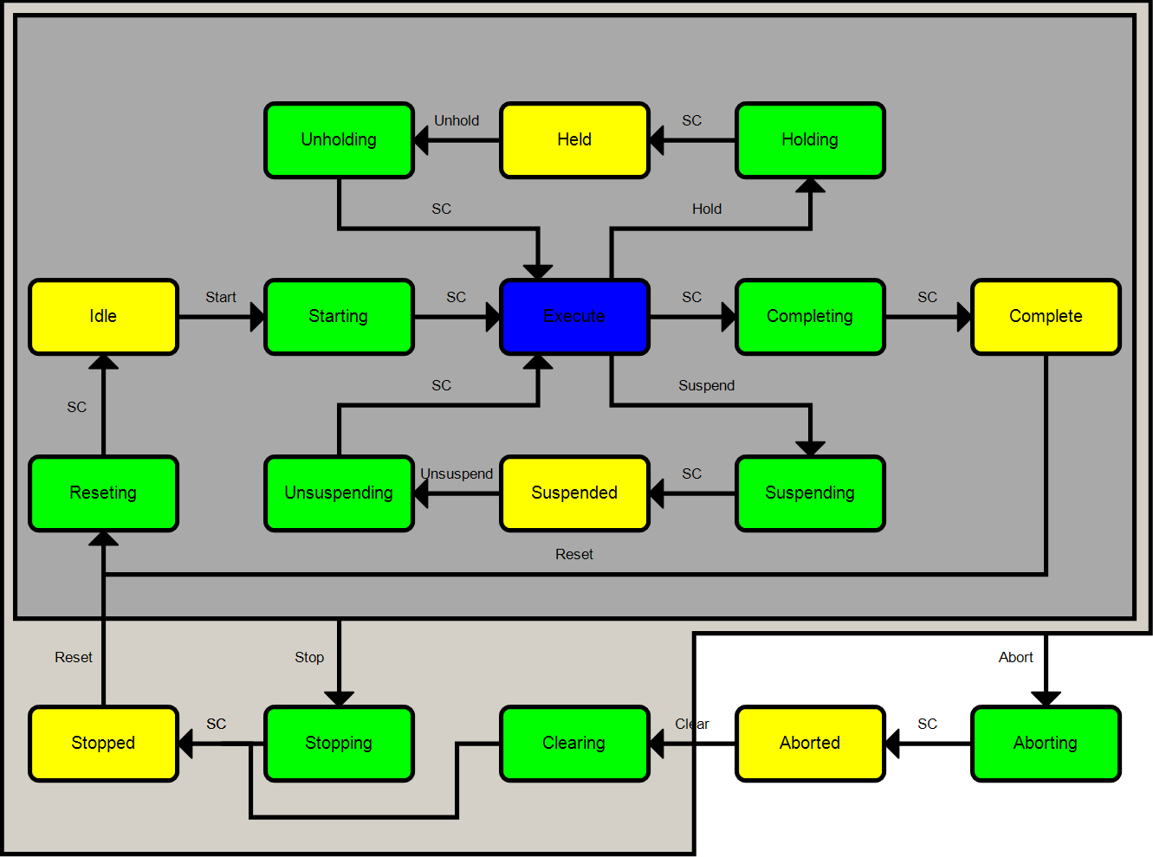
PackML State Engine
17 States
32 modes
All configurable
Can use as little as one mode and 5 states
We support the use of all modes and states

Slide 8
PackML PackTags
Tags define how the program communicates with other machines and higher-level control systems
3 Types of tags
Command – Used by the machine to make a change from outside
Status – Written by machine to be used elsewhere
Current State, Current Mode, etc..
Admin – Used for analysis, operator information and units produced
Data needed for OEE – State Times, products produced, defective, etc…
Stop Reason, Last 10 Alarms

Slide 9
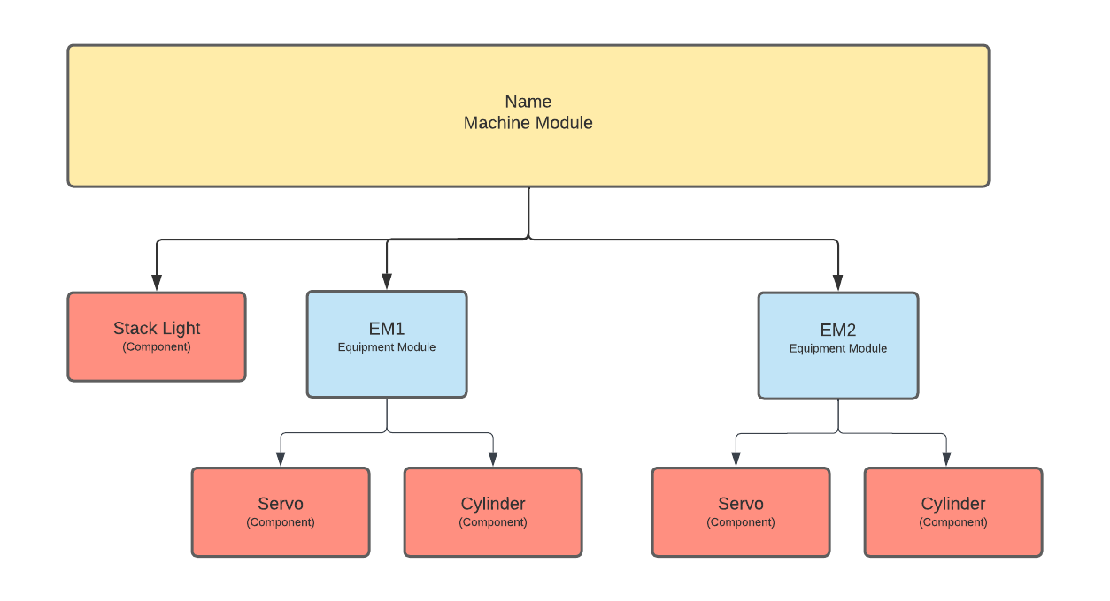
PackML Machine Module / Equipment Module / Component
Machine (Unit)
An entire machine – Filler, Capper, Wrapper, etc..
Equipment Module
A station or section of machine – Infeed, filler, outfeed, etc..
Component(Control Module)
An actuator or piece of equipment – Servo, VFD, Sensor, etc..
An application can also just be a Machine Module and some Components

Slide 10
PackML Implementations
2 ways to implement
Intermediate interface to existing PLC code and translate local states to PackML Tags and PackML definitions
Run machine using PackML State Engine and Machine / Equipment / Component method and PackML Tags
We wrap the PackML overhead into our framework so you can put your effort into application programming.

Slide 11
SPT Framework - Overview
Template PLC project
Machine Module Function Block(FB)
Template FB for Equipment Modules
Template HMI starter project
Header
Navigation
Start/Stop/Reset
Content Area
Alarm Notification & Display
SPT user controls
Set of Libraries to support the modules and components
Code uses Object Oriented Programming(OOP) methodology in Structured Text
Notes:
Show the libraries in TwinCAT or Beckhoff-USA-Community

Slide 12
SPT Framework – Base Types
FB_BaseFB
Properties: Busy, Error, ErrorID
Methods for Tracing Messages
FB_CyclicFB
Property: InitComplete
Method CyclicLogic
Extends FB_BaseFB

Slide 13
SPT Framework – PackML Base
The Machine module and Equipment module are based on the FB_PackML_BaseModule that extends FB_CyclicFB
This base code handles the Mode/State changes
Handles the raising of alarms to the parent
All states have a base functionality that can be overriden in a module
HMI tags for integration with HMI User Controls
Calls all the subModules CyclicLogic and Components CyclicLogic

Slide 14
SPT Framework - Components
A component is an extension on the FB_ComponentBase
A component is the connection between the software and hardware
Components can be in the machine module or any equipment module
We have a wide range of predefined components from Axes to device specific components like a FanucRobot interface
Many others and the library of components is growing

Slide 15
Alarms with TwinCAT Event Logger
The TwinCAT built in Event Logger is used for Alarming
5 levels of severity: verbose, info, warning, error, critical
TwinCAT HMI can be easily integrated
Configurable reaction to alarms at equipment and machine module
Alarms are used to fill the Pack Tags

Slide 16
GIT Hub
Beckhoff USA · GitHub
SPT Libraries – link
VFFS Demo
PackML_PLC_Example - link
PackML_HMI_Example - link

Slide 17
Questions ?

Slide 20
03/2022

